Slide 1
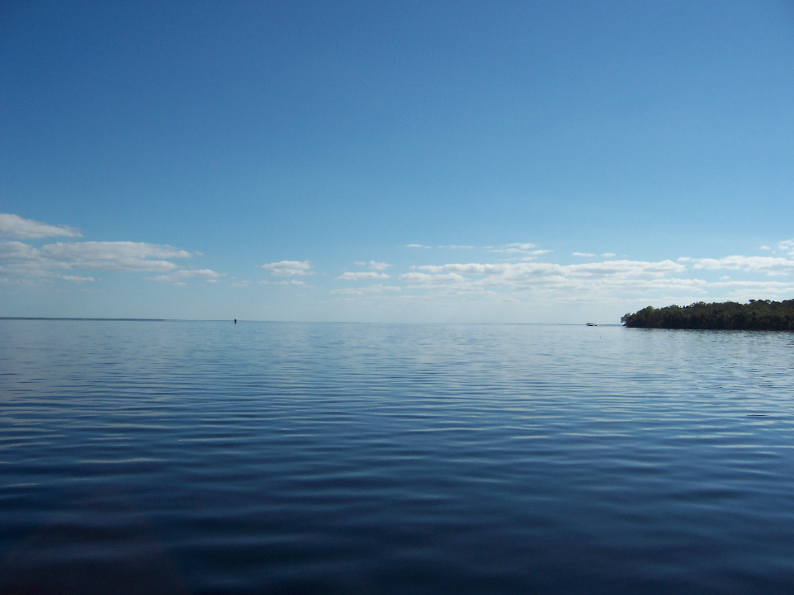
Jimmy Orth
Executive Director

Slide 2
REVISED HUMAN HEALTH-BASED CRITERIA
FDEP revised 43 existing HHC
Approximately half of the revised criteria are higher than the existing criteria
Proposed HHC for 39 new compounds
Limits for at least 66 of the 82 chemicals are higher than the EPA-recommended limits

Slide 3
LESS PROTECTIVE MODEL
Probabilistic Model – Less Conservative, Higher Limits
Deterministic Model – More Conservative, Recommended by EPA
FDEP used the Probabilistic Model

Slide 4
HIGHER RISK LEVELS
EPA recommends risk level of one in one million (1:1,000,000) for the 90th percentile of the population
FDEP chose risk level of one in one million (1:1,000,000) for the average Floridian
FDEP also chose less protective risk levels for many of the individual chemicals

Slide 5
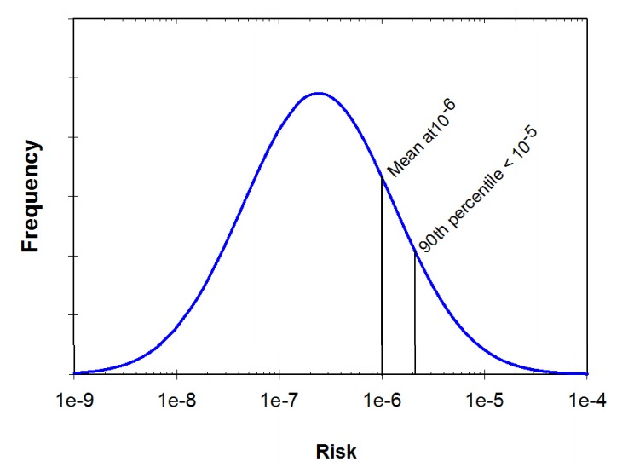

Slide 6
EPA RECOMMENDATIONS
Pollutant | CAS No. | Class I (ug/L) | Class III (ug/L) | Published | EPA Notes
FDEP PROPOSED CRITERIA
Pollutant | CAS No. | Class I (ug/L) | Class III (ug/L)
1,2-Dichlorobenzene |  | 1,400 | 3,900 |  | 40% increase - drinking water 30% increase – Class III waters
1,2-Dichloroethane |  | 22 | 1,200 |  | 122% increase - drinking water 85% increase – Class III waters

Slide 7
HIGHER FISH CONSUMPTION RATE (FCR)
Current criteria based on 6.5 grams/day
National FCR (90th percentile) = 22 g/day
Florida Atlantic Region = 29.17 g/day
Subsistence fishers = 142.4 g/day or about one 5-ounce meal of Florida fish per day
Increased fish consumption = more chemicals ingested = higher risk for cancer

Slide 8
HIGHER FISH CONSUMPTION RATE
Current criteria based on 6.5 g/day
National FCR (90th percentile) = 22 g/day
Florida Atlantic Region = 29.17 g/day
Subsistence fishers = 142.4 g/day or about one 5-ounce meal of Florida fish per day
Increased fish consumption = more chemicals ingested = higher risk for cancer

Slide 9
HIGHER FISH CONSUMPTION RATE
Chance of cancer for “regular (weekly) consumers of Florida fish” would increase to one in a hundred thousand (1:100,000)
Subsistence fishers and those who eat fish more frequently would be exposed to a risk level of up to one in ten-thousand (1:10,000)

Slide 10
SYNERGISTIC INTERACTION
According to FDEP: “A chemical-by-chemical assessment of risk, as conducted in this analysis, could underestimate risks from more than one chemical in combination.”
Exposure to more than one contaminant at the same time can “produce a cumulative or even synergistic toxicity.”
Halifax Project, an international consortium of 174 scientists from 26 countries, concluded that some chemicals considered non-carcinogenic in isolation may increase cancer risk when present in the environment in certain mixtures.

Slide 11
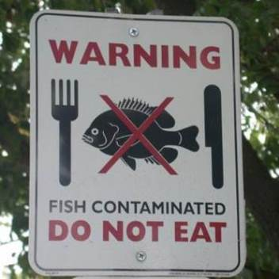
WHO BENEFITS?

